Slide 1
Thank You to our Premiere Sponsor
Joe Holman,
Director of New Business

Slide 2
Thank You to our Gold Sponsors
Bartlett Tree Experts Harris
Legacy Cleaning Kraus Anderson
Prescription Landscape
RSP
Savatree

Slide 3
Thank You Board of Directors!
Trenna Ross, CFM
President
Allecia McDonald
Vice President
John Viktora-Croke
Treasurer
Rhonda Small, FMP, SFP
Secretary & Director - Communications / Programs
Jon Heaton
Immediate Past President
Laura Magnuson, CFM
Director - Professional Development & Outreach
Brian Comiskey
Director - Events
Nick Edwards
Director - Programs
Eric Walsh
Director - Events
Jason Popovich
Director - Membership

Slide 4
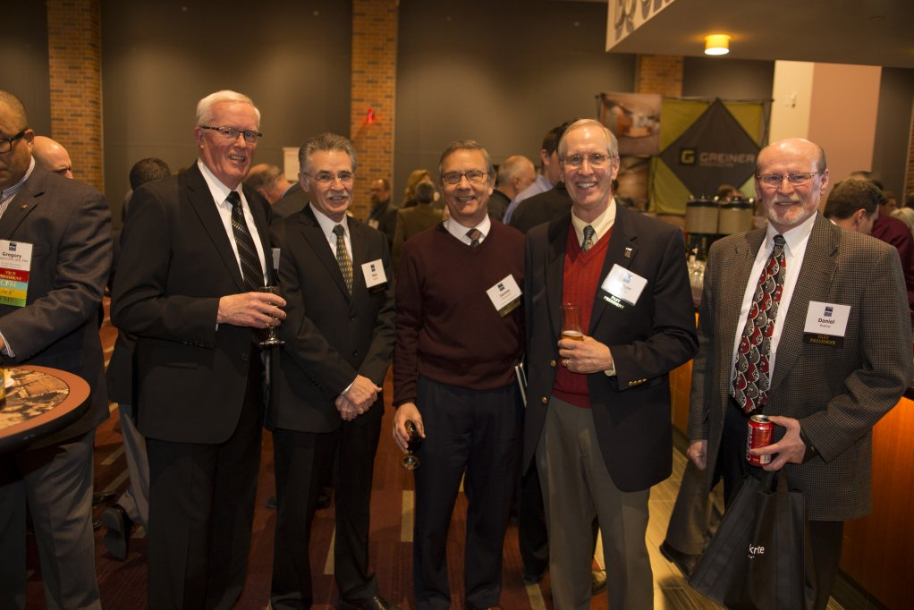

Slide 22
Past Presidents
1984 – 1985 Rodger McCombs
1985 – 1986 Rodger McCombs
1986 – 1987 Paul Thone deceased
1987 – 1988 Jack Yates
1988 – 1989 Dan Brathal
1989 – 1990 Caren Olson deceased
1990 – 1991 Al Amiot
1991 – 1992 Sharon Harrington
1992 – 1993 Peggy McCarthy
1993 – 1994 Blaine Bartz deceased
1994 – 1995 Beth Eder
1995 – 1996 Paul Carlson
1996 – 1997 Wendy Gilbertson
1997 – 1998 Theresa Sposito
1998 – 1999 Debra Pasvogel
1999 – 2000 Leslee Yoder
2000 – 2001 Jay Schrader
2001 – 2002 Peter Hillman
2002 – 2003 Ann Kastensen
2003 – 2004 Steve Lockwood
2004 – 2005 Fred Atkinson
2005 – 2006 Kristine Fisher
2006 – 2007 Tom Shultz
2007 – 2008 Paul Wallerius
2008 – 2009 Greg Goeke
2009 – 2010 Brian Woolsey

Slide 23
Past Presidents
2010 – 2011 Rebecca Seltz
2011 – 2012 John Ewine
2012 – 2013 Bill Howden
2013 – 2014 Bill O’Neill
2014 – 2015 Greg Williams
2015 – 2016 Rhonda Rezac
2016 – 2018 Greg Wood
2018 – 2020 Laura Magnuson
2020 – 2022 Jon Heaton

Slide 36
IFMA MSP Certifications by the Numbers
30
CFM
7
SFP
39
FMP

Slide 46
Milestones 1980 – 2000
1980: National Facility Management Association (NFMA)
1982: NFMA becomes IFMA
1984: MSP Chapter becomes 15th Chapter
1985: MSP Education Committee developed a model curriculum
1988: Minneapolis/St. Paul Chapter sweeps Awards of Excellence

Slide 62
Milestones 2000 – Current
2002: IFMA Fellows Class of 2002 Peggy McCarthy
2006: IFMA Fellows Class of 2006 Sharon Harrington, CFM 2007: Membership peaked at 440!
2013: Minneapolis/St. Paul Chapter wins Chapter Award of Excellence in Professional Development Minneapolis/St. Paul Chapter
2014: established MSP IFMA scholarship at University of Minnesota
2024: FM Pipeline is entered as part of the State of Minnesota competition

Slide 74
Legacy Sponsors: 10+ Years
ABM Onsite Services | Sheila Hanson Alliiance | Carey Brendalen
Bartlett Tree Experts | Jon Heaton CFS Interiors & Flooring
City Wide Maintenance | Tyler Olson
CORT | Carey Sanders Harris | Tom Danley INSEPC | Jason Popovich
Kraus Anderson | Dustin Phillips
Mohagen/Hansen | Sue Kimbrel Prescription Landscape | Eric Walsh Prevolv | Jenna Doege
RSP | Rhonda Small
SOLID Surface Care | Catelyn Maloney

Slide 83
Legacy Members: 15+ Years
Sharon Harrington | RCFM, FMP, IFMA Fellow Peggy McCarthy | CFM, IFMA Fellow
Carol Larson Jason Kringle James Norkosky Kari Kafehl Vesel
Kristine Fisher | CFM
Peter Hillman | CFM Andrew Dykstra | CFM, FMP Paul Theisen | CFM
Michael Lexvold | CFM
Robb Jensen
Larry Hartmann | FMP, CFM
Jeff Drews
Tatiana Peden | CFM Douglas Fischer Timothy Pladson Doug Elser
Charlene Meuwissen | FMP
David Behrman | FMP Scott Vreeman
Debra Barnes
Steve Keene | CFM, FMP Kevin Maas
Kyle Anderson | FMP, FMA,
Master Facility Executive

Slide 84
Legacy Members: 15+ Years
Susan Muehler | CFM, FMP Thomas Eineichner
Chad Conoryea | CFM, FMP Laura Magnuson | CFM Karston Anderson
Jodene Woods
Chad Wollak | FMP Dana Krakowski Michael Quast | FMP
Gregory Wood | SFP, CFM

