Slide 1
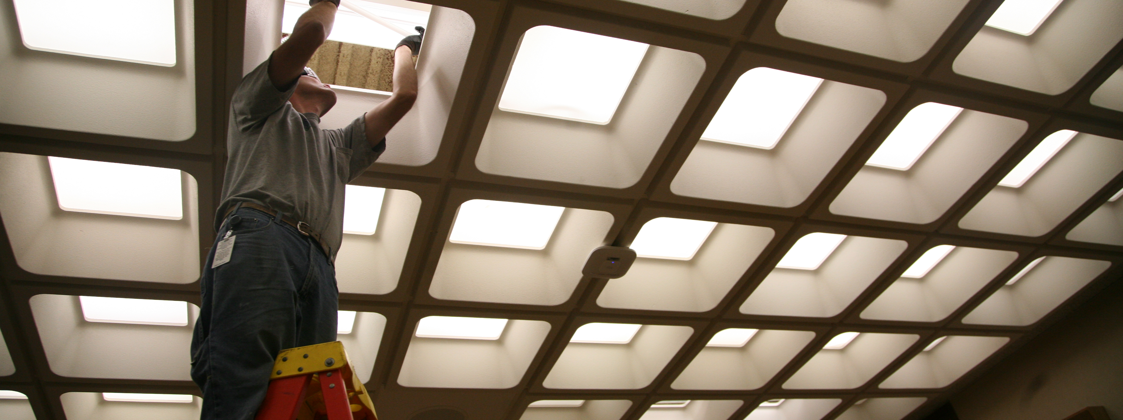
Sustainability: Energy Conservation Efforts
How to set your image in the placeholder
Right click image and select “format picture”
Select “Picture” tab
Select Crop from the drop down menu
Under Picture Position, use the Offset X and Offset Y to position your image within the frame
delete this when no longer needed
Leah Hiniker, Facility Services Hennepin County
Notes:
Leah -
Thank you for your interest in this topic of energy and your time today.

Slide 2
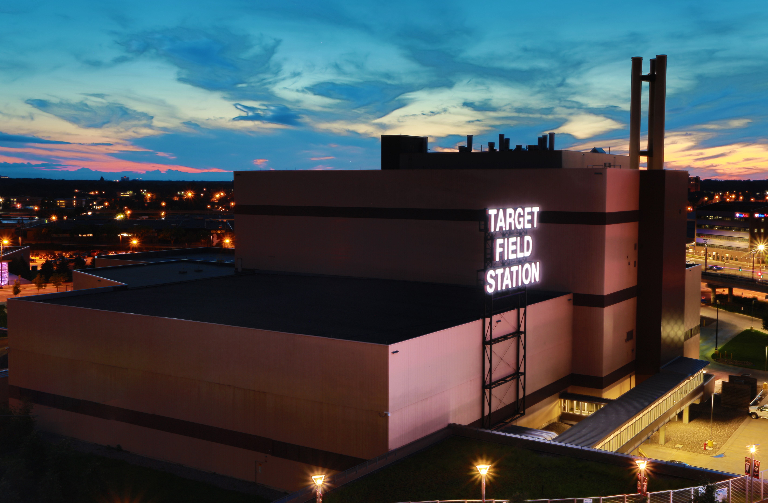
Vision
Have reliable sources of energy to support critical services and use energy responsibly.
Make strategic investments in our energy future maximize environmental benefits and trim the cost of energy consumed.
Provide regional and national leadership in energy conservation, efficiency and renewable production.
Notes:
Leah
Our vision is to provide reliable energy to the county’s buildings while being a steward of the environment and fiscally responsible. We aim to lead the industry by investing in energy efficient technologies and strategies such as a waste to energy facility and high-performance buildings.

Slide 3
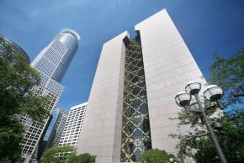
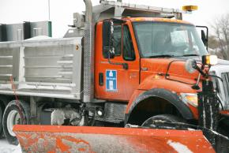
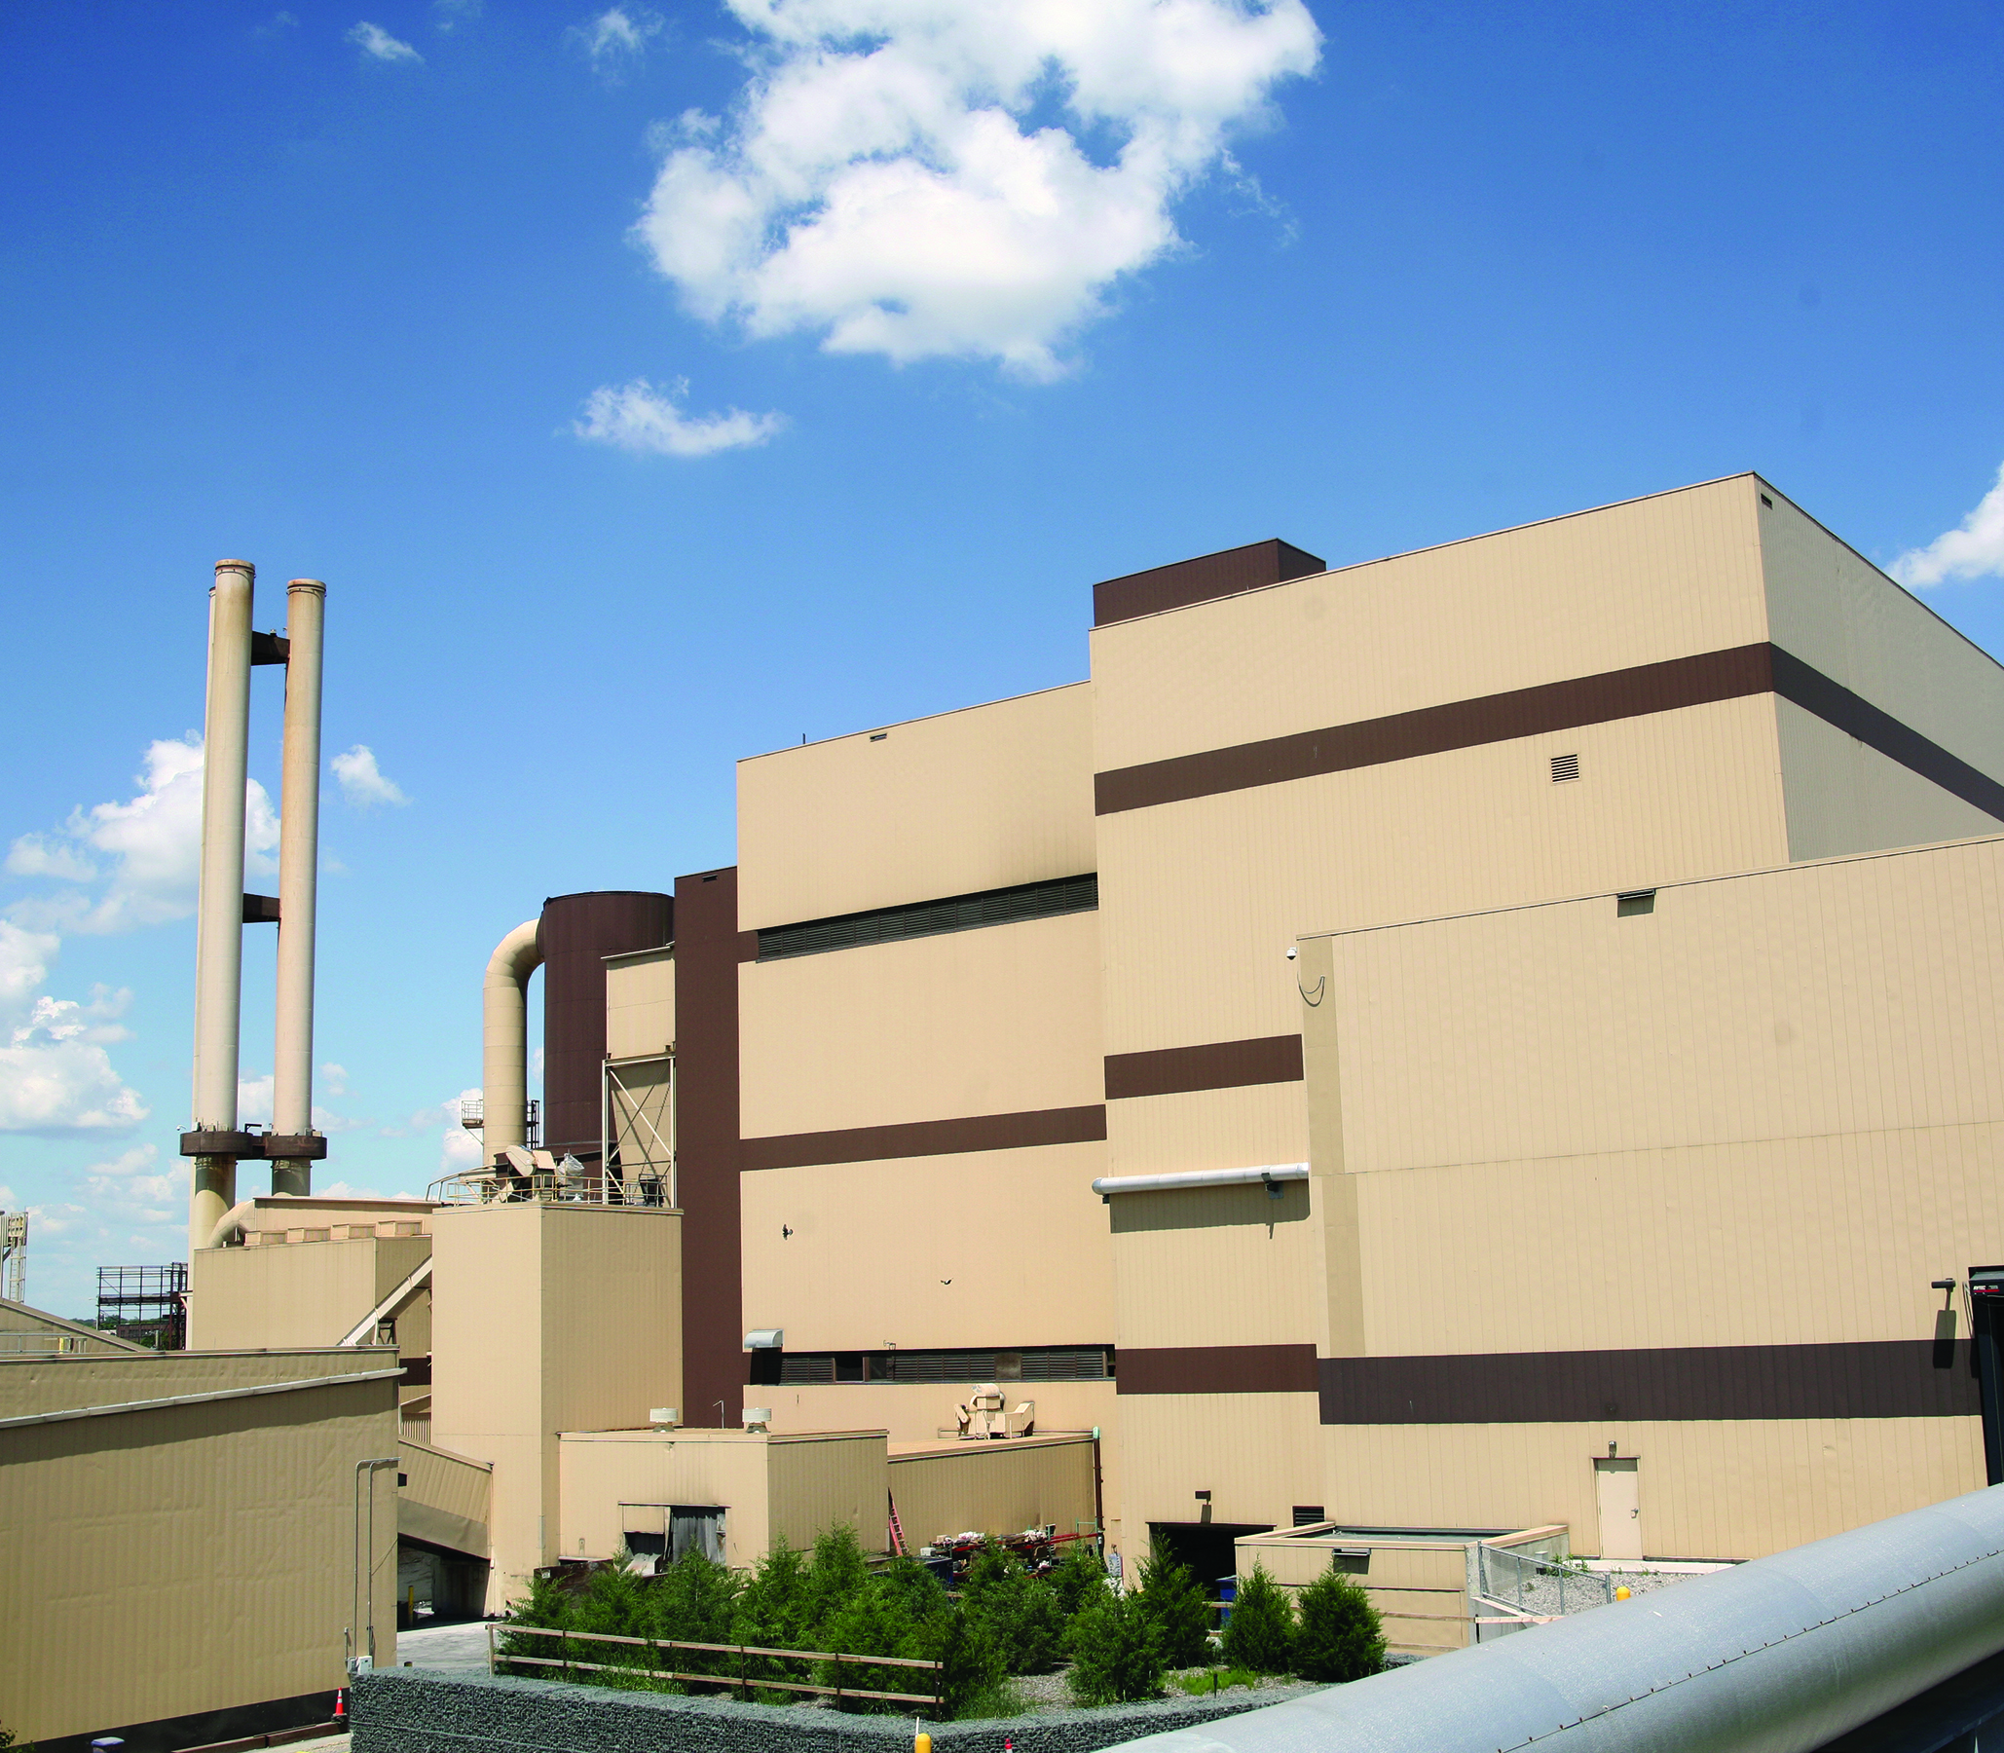
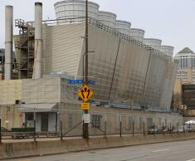
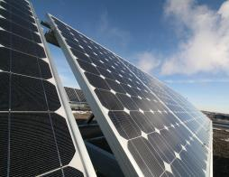
Energy in Hennepin County
Consume energy
conducting county business
Produce energy
Buildings
Fleet
HERC
Energy Center
Solar
Notes:
Leah
Hennepin County is unique as a county as it not only consumes energy, it produces it. Buildings are the primary consumer of energy comprising of 85% of the total energy used. Fleet comes in second with 9% of the energy use.
The county owns two facilities that generate energy as well as a solar array located at the Medina Public Works Facility. The HERC Facility is a combined heat and power facility that exports approximately 31 megawatts to Xcel Energy’s power grid - enough to power 25,000 homes.
HERC also provides steam to downtown district energy and Target Field.
The Energy Center provides steam and chilled water to the HCMC campus, six county buildings, and three private customers totaling over 6 million square feet of space. The Energy Center can produce 310,000 pounds of steam and nearly 16,000 tons of chilled water.
On average the solar array at Medina generates115,000 kilowatt hours per year. Over its life time the solar array has generated 932,000 kilowatt hours of electricity. (Provides less than 1% of total county energy needs)

Slide 4
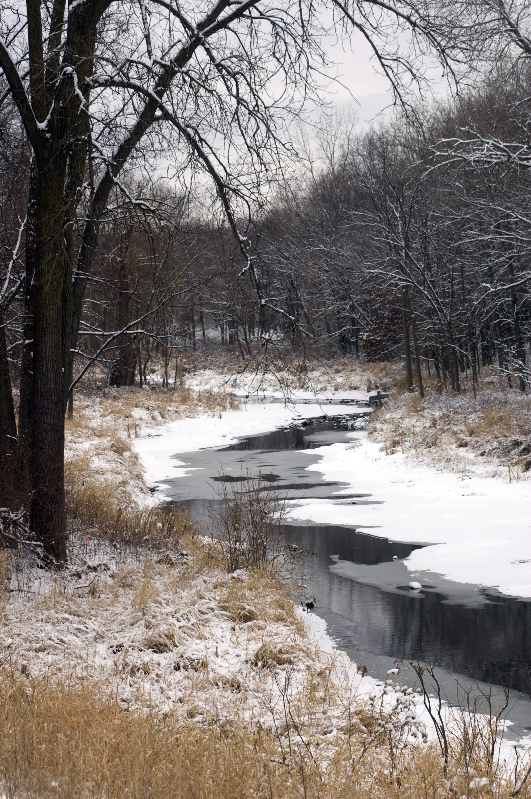
Why is conserving energy important?
Helps mitigate climate change
Improves air quality to protect public health
Saves money
Notes:
Greenhouse gases are released when fossil fuels are burned. These gases have been known to cause climate change which causes extreme weather conditions. Air pollution as a whole causes increases in health related issues such as asthma and cardiovascular diseases. When energy is conserved or used more efficiently, there is a subsequent reduction in air pollution.
Reducing our energy use also reduces our energy costs. As electricity rates continue to increase by nearly 3%, reducing energy can offset these rate increases.

Slide 5
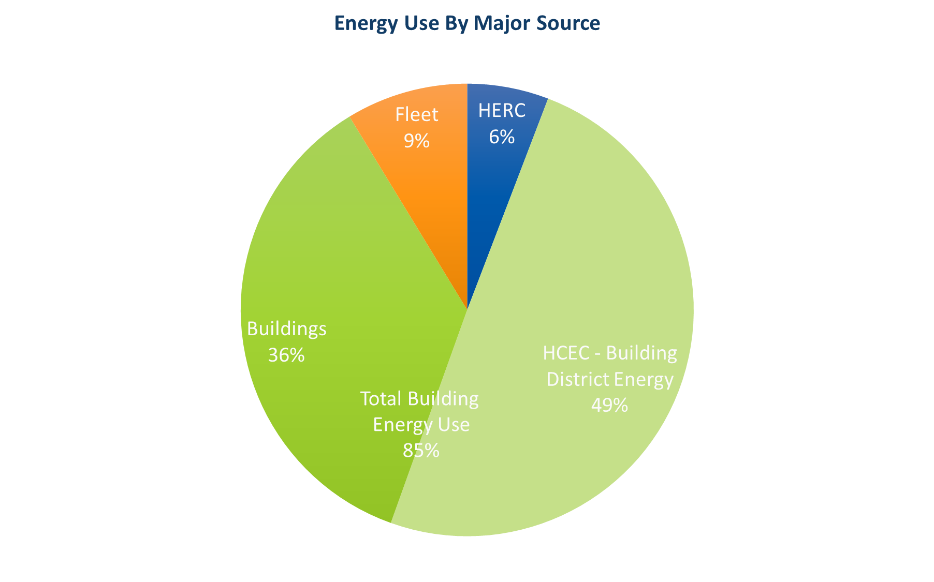
Energy Use by Type

Slide 6
Energy Reduction Goal
20% ⬇
by
2020
Notes:
Facility Services has set a goal of reducing energy use by 20% by the year 2020. This equates to 3% annually over 7 years starting in 2014.
As you can see, we are on our way to reach these goals all due to the efforts of high-efficiency building design, recommissioning, lighting upgrades, building controls and operation and maintenance efforts. Currently we are at 11.6%, just shy of our 12% target. Some of the challenges we are facing include increases to electronic equipment including computers and servers and extended building hours.

Slide 7
Direction Ahead
Renewable
energy
Energy efficiency
Windows, insulation, new technology, high efficiency building construction/renovations, HVAC upgrades, LED lighting and controls
Energy conservation
Building automation controls, recommissioning/commissioning,
temperature guidelines, equipment scheduling, education
Hydro Power
Biomass
Wind
Waste-to-Energy
Solar
Future energy efforts:
Large capital building projects
(new and remodeling)
Energy efficiency capital projects
Continuous improvements
in operations
Employee
engagement
Complexity/Resource investment
Notes:
This pyramid depicts the energy reduction efforts moving forward for the county. As we work our way up the pyramid, energy reduction becomes more capital and resource intensive. Our focus moving forward is to improve and maintain energy conservation efforts. We plan to implement an employee engagement campaign to help bring awareness to these efforts. We are also going to be investing in more deep retrofits of our buildings including window replacements and increased insulation. These investments will allow us to increase energy efficiency while improving staff comfort and preserving the county’s assets.
Being a good steward of the environment not only means using less energy, but using cleaner energy. Investing in renewable energy sources helps reduce our reliability on coal fired electricity plants. We currently generate less than 1% of our energy use from solar and have subscribed another 4% into the community solar gardens program. We will not be able to able carbon emission reduction goals without investing in renewable energy sources such as solar. Setting a goal will set design criteria for projects moving forward.

Slide 8
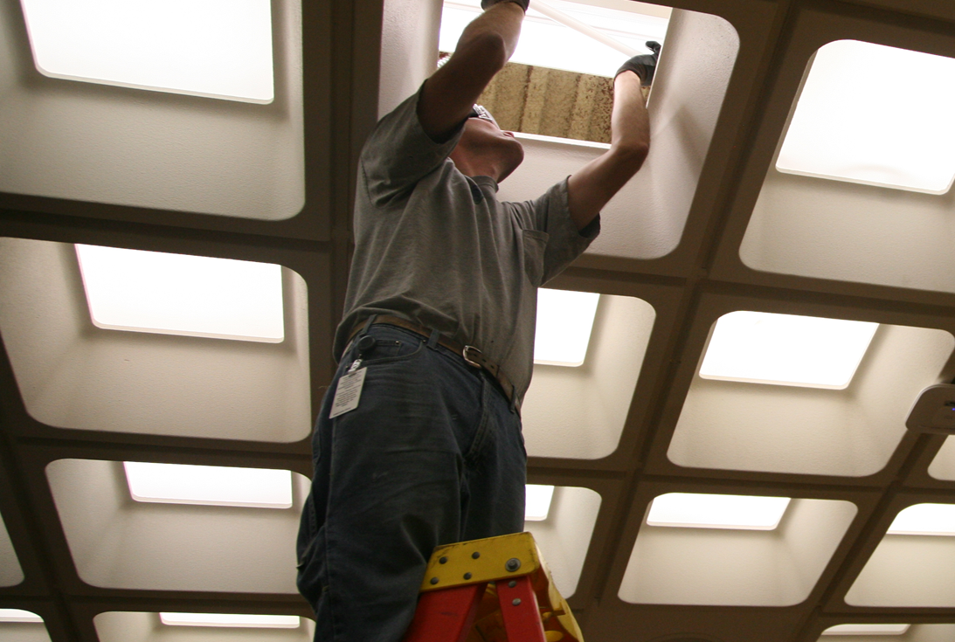
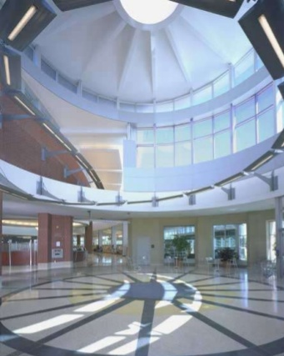
Buildings
Daylighting and controls:
Reducing lighting when sunny
Occupancy controls
Dimming
LED Lighting:
60% more energy efficient
Less maintenance
Better light quality

Slide 9
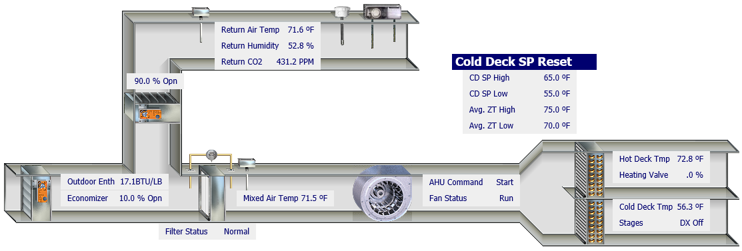
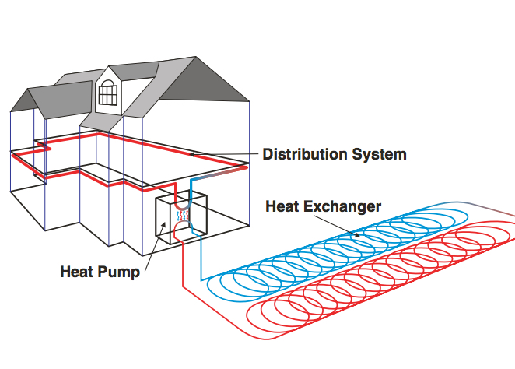
Buildings
Geothermal:
  30-60% more efficient
  Uses heat from the ground
Building Automation Systems:
Controls HVAC and lighting systems
Recommissioning:
Building tune-up
5-25% energy savings

Slide 10
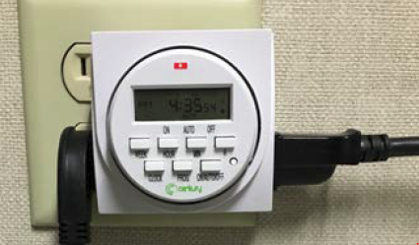
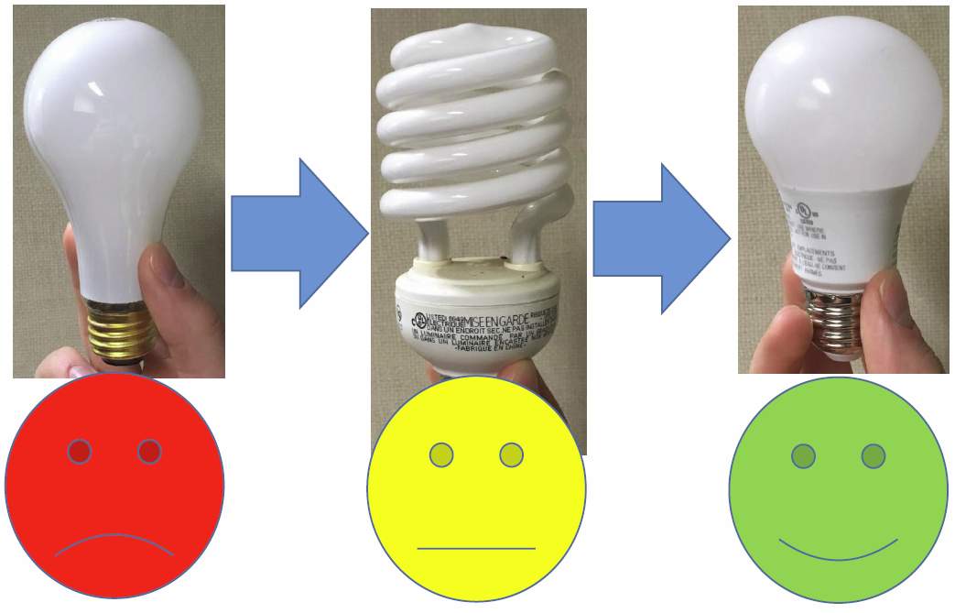
EmPower Employee Behavior Campaign
Lightbulb exchange:
  Replaced 517 lightbulbs
  Saving 30,000 kWh annually
Plug in timers:
  Turns off plug loads via timer
  52 timers installed

Slide 11
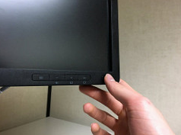
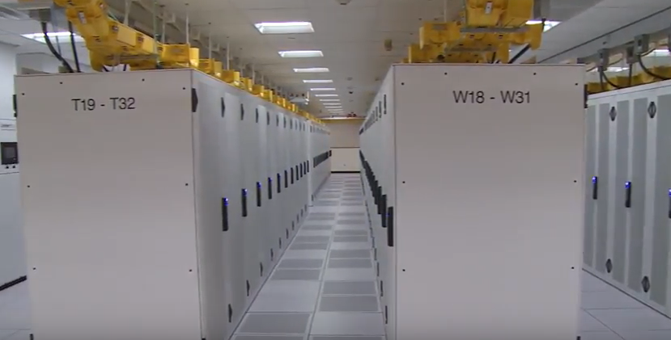
IT and Data Center
Data center:
  LED Lighting and occupancy sensors
  Hot/cold isle technology
  Dry coolers
Computers:
  Energy Star rated laptops
  Automatic sleep mode on monitors

Slide 12
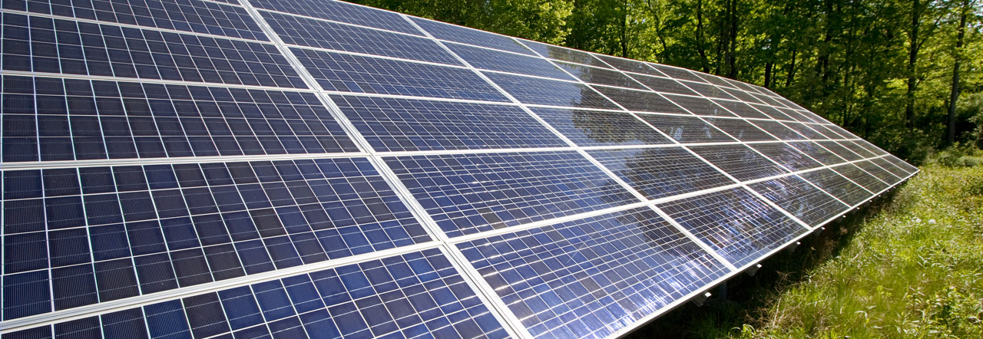
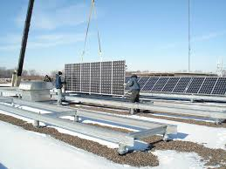
Renewables
Solar Array:
Medina Public Works - 2009
  80 kW solar array
  528 modules at 185 watts
Community Solar Gardens:
  10 solar arrays
  4,067 kW solar load
  10% electricity load

Slide 13
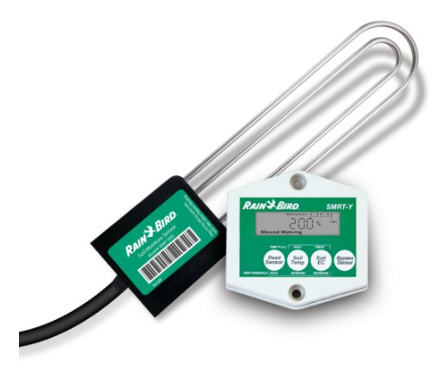
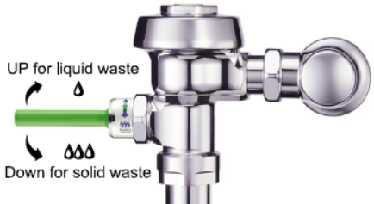
Water Conservation
Low flow faucets and toilets
Moisture sensing irrigation systems

Slide 14
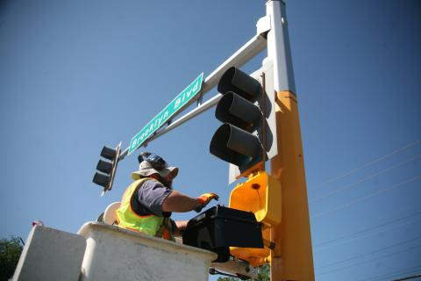
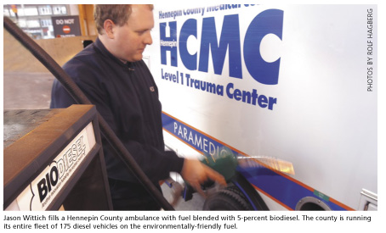
Transportation
Fuels:
E85 – flex fuel vehicles
Biodiesel blends
Hybrid vehicles
Electric vehicles
Traffic Lighting:
Signals converted to LED
Street lighting converted to LED
Hennepin Avenue bridge lighting converted to LED

Slide 15
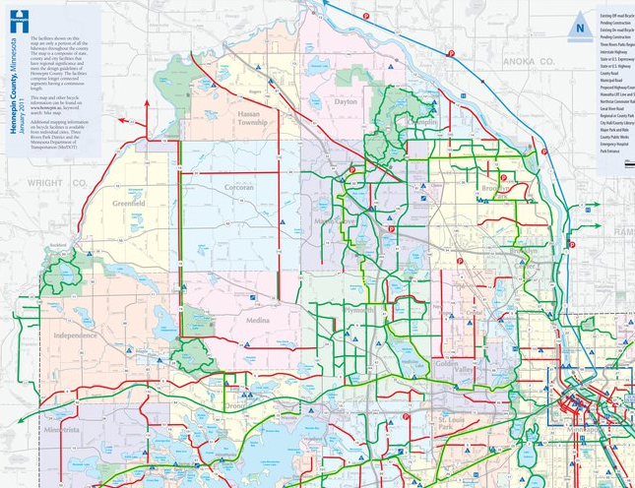
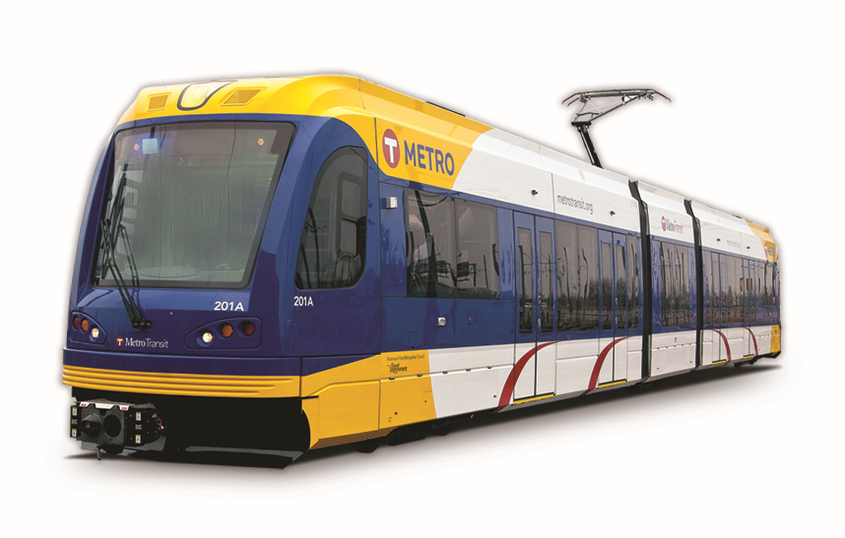
Transportation
Light rail line:
Less emissions
Less vehicles on the road
Bike paths:
500 miles of bike paths
Reducing vehicle miles traveled

Slide 16


Waste Reduction
Recycling:
Single sort
Organics
50% waste recycled
Fix-It Clinics:
1,000 items fixed annually
7000 pounds diverted from landfills

Slide 17
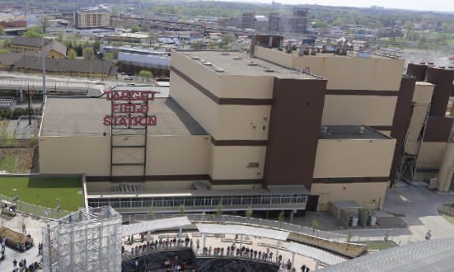
Hennepin Energy Recovery Center
365,000 tons of trash burned annually
Converts trash to energy
Burns trash to produce energy
Produces steam and electricity
Reduces use of landfills

Slide 18
Greenhouse Gas Emission Reduction Goals
15% ⬇
by
2015
25% ⬇
by
2025
80% ⬇
by
2050
✓met goal
➔on track
⬆ efforts to meet goal
Notes:
Update GHG chart
Leah
In 2007, Hennepin County established a goal to help mitigate climate change by reducing greenhouse gas emissions by 80% by the year 2050. Currently we are on track to meet the interim milestone goals, but strategies to meet the aggressive 2050 goal have not been determined. We have been able to meet our current goals with the help of Xcel Energy’s dedication to provide electricity using cleaner energy sources.
Xcel Energy’s Resource Plan Goals by 2030
Provide 85 percent of our energy from carbon-free sources
Reduce carbon emissions by 60 percent from 2005 levels
Continue our transition from coal to clean energy, including renewables and natural gas
Operate our nuclear fleet through their current licenses
Accelerate renewable energy development; by 2030, 35 percent of the electricity we provide would be from wind and solar resources

Slide 19
Thank you!
Leah Hiniker
Energy Manager
Hennepin County
Leah.Hiniker@Hennepin.us
612.543.1219

Slide 20
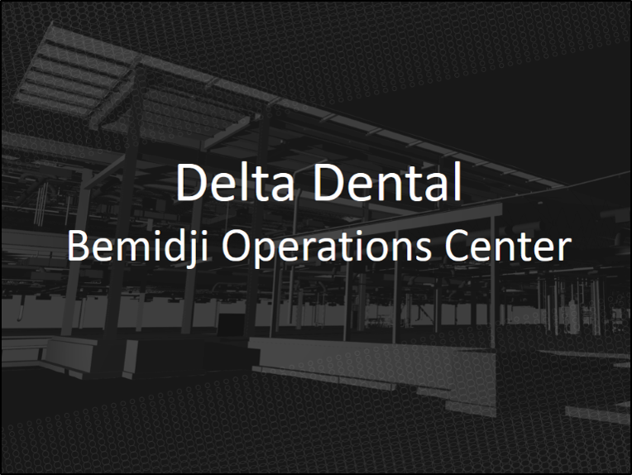
Matt Stringfellow, LEED Green Associate
Mechanical & Electrical Systems Manager
Kraus-Anderson Construction Company

Slide 21
Sustainability is about more than just saving energy (Example: Delta Dental Bemidji Operations Center)
Renewed focus on more livable environments for building occupants (i.e. Well Building Standard)
Psychological effects of space
Psychological effects of daylight
Psychological effects of noise
More user amenities in buildings
  Comfortable breakout and collaboration areas
  Physical exercise areas
  Bicycle storage/repair
  Family restroom facilities
  Mother’s rooms
  Wellness room

Slide 22
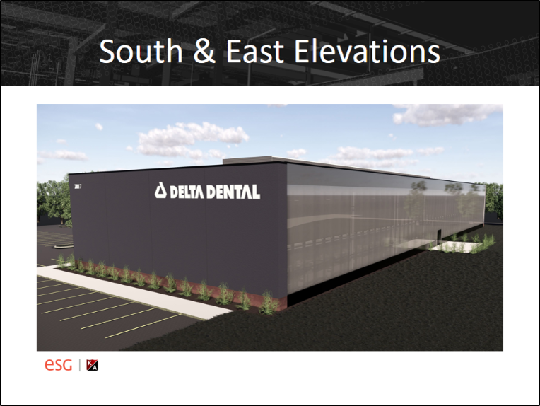

Slide 23
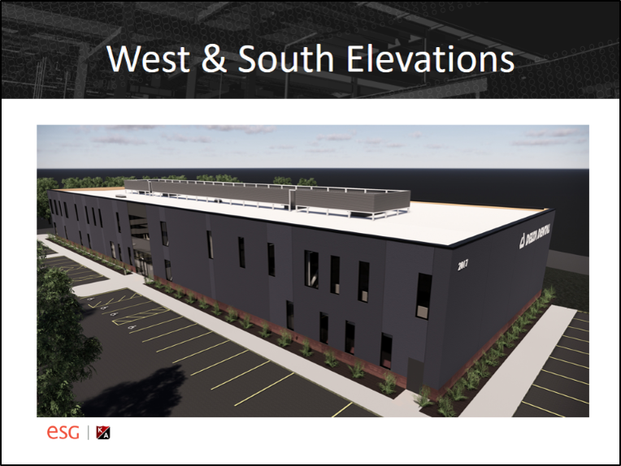

Slide 24
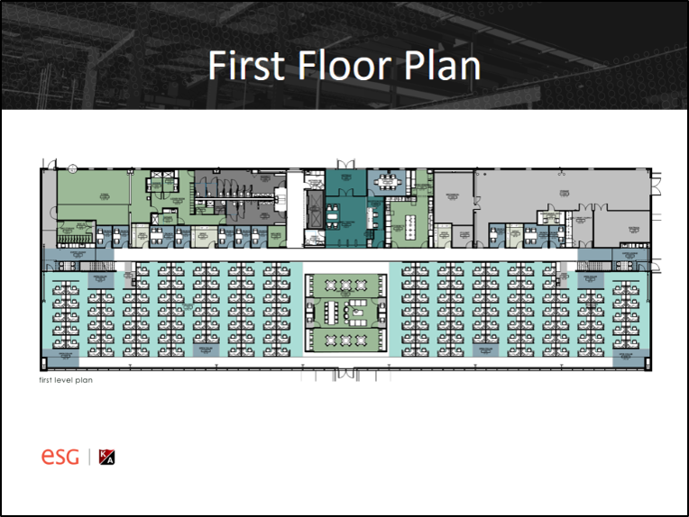

Slide 25
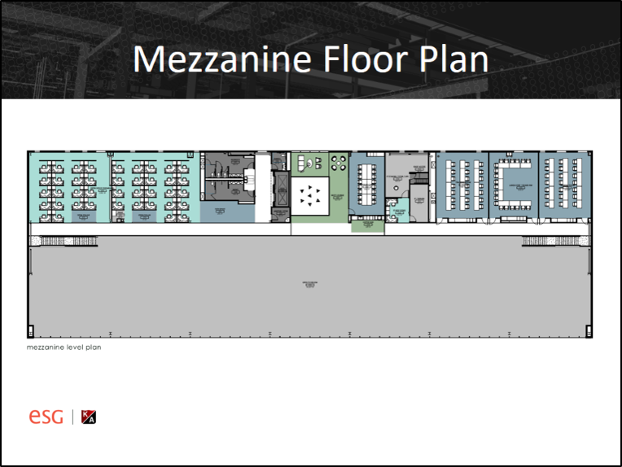

Slide 26
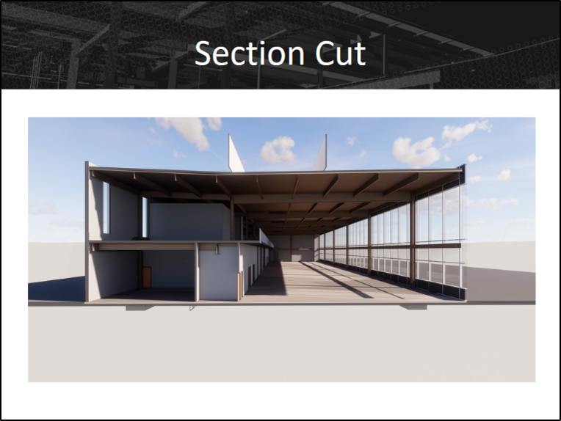

Slide 27
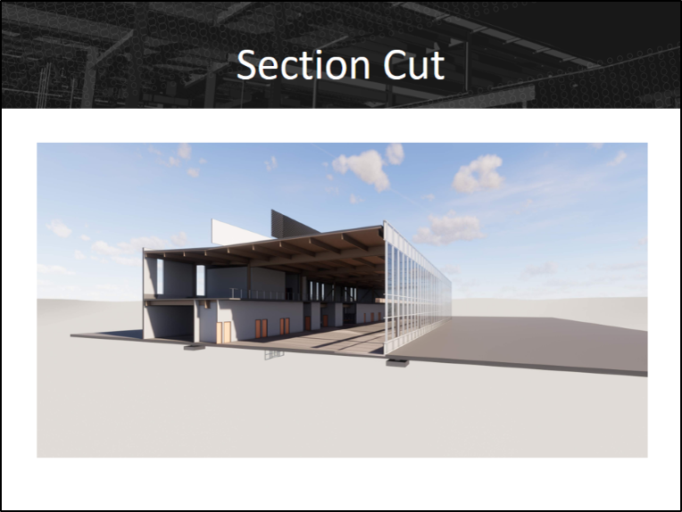

Slide 28
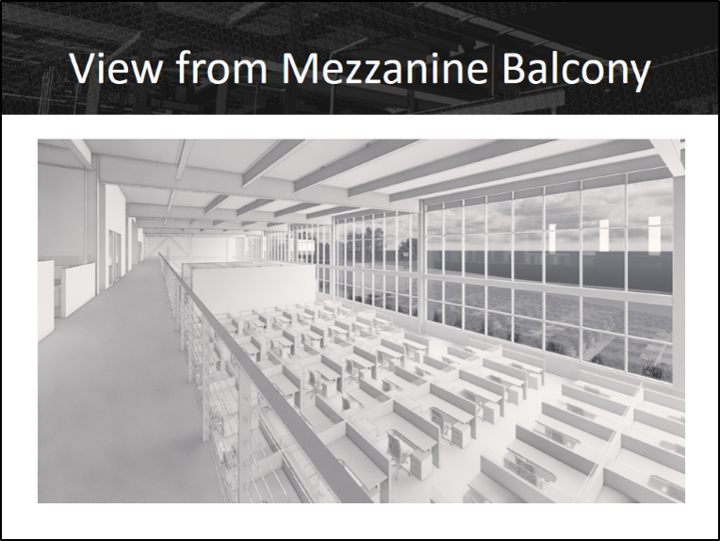

Slide 29
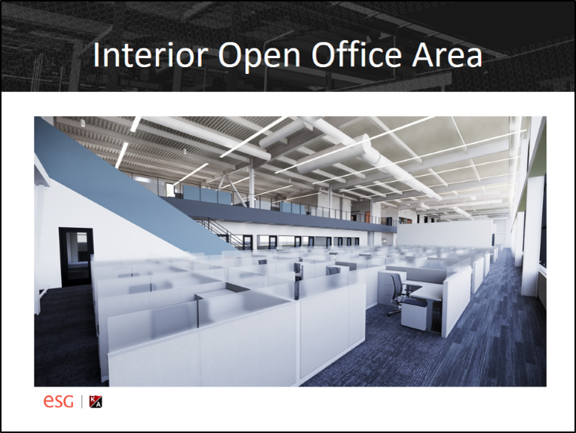

Slide 30
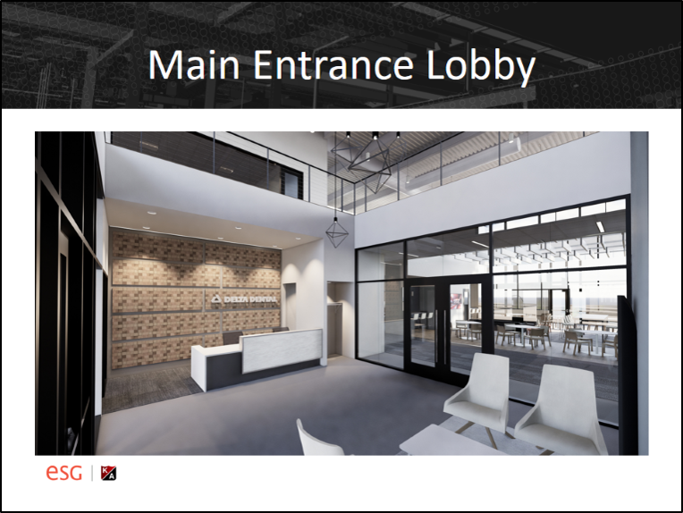

Slide 31
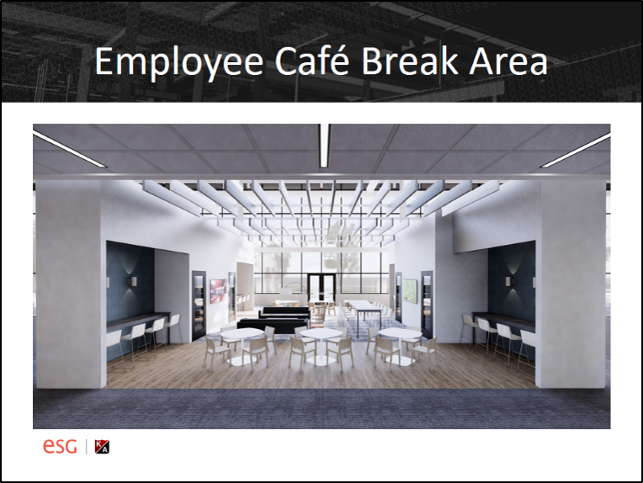

Slide 32
JR. ACHIEVEMENT OF THE UPPER MIDWEST:
REIMAGINING A 100-YEAR-OLD BUILDING

Slide 33
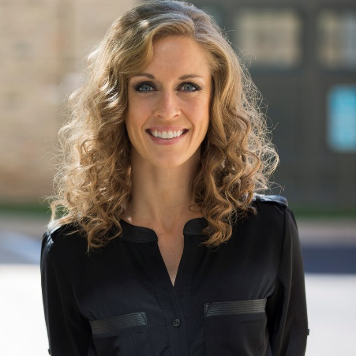
Hello.
Jennifer Buck
AIA, LEED AP BD+C
Senior Associate

Slide 34
Project Team
RSP – Architect
JAUM – Owner
  Gina Blayney and Jolene Hart; JAUM board members
Owner’s reps – Michelle McGuire and Wendy Rogers
Mortenson – General Contractor
Anderson Companies – Pre Construction Pricing
ERA – Structural Engineers
Emanuelson-Podas – MEP engineers

Slide 35
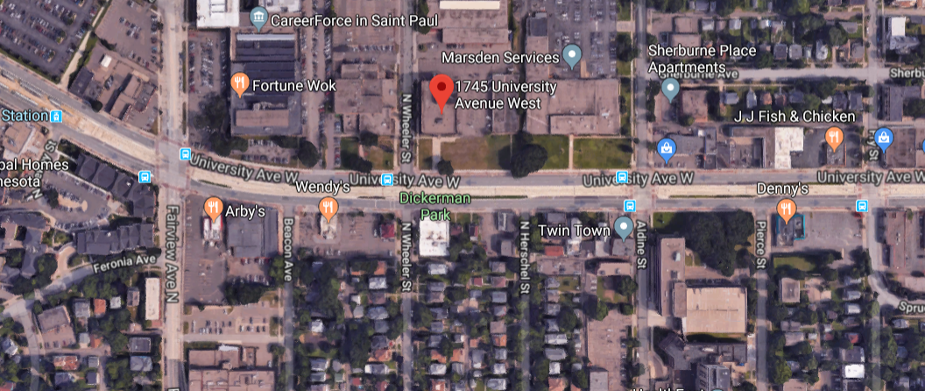
Selected Site – 1745 University Ave West

Slide 36
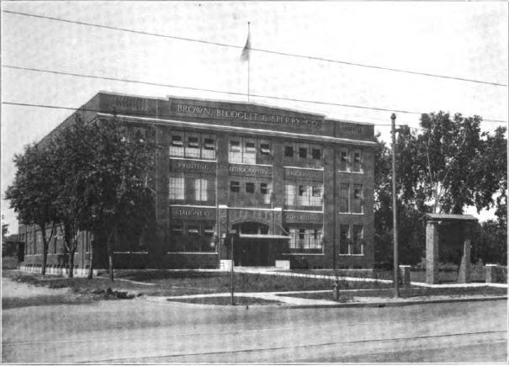

Slide 37
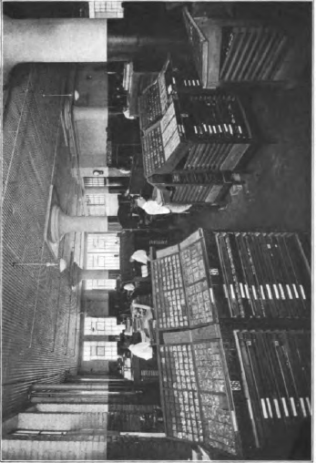
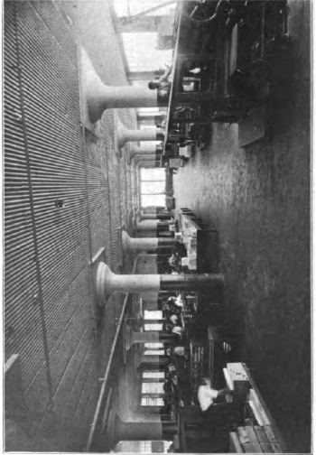
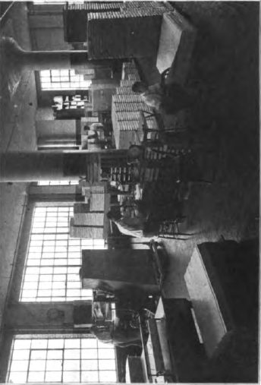

Slide 38
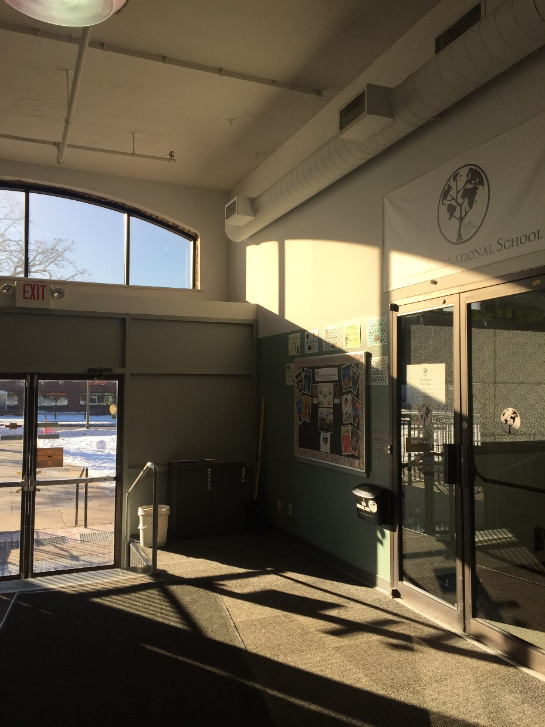
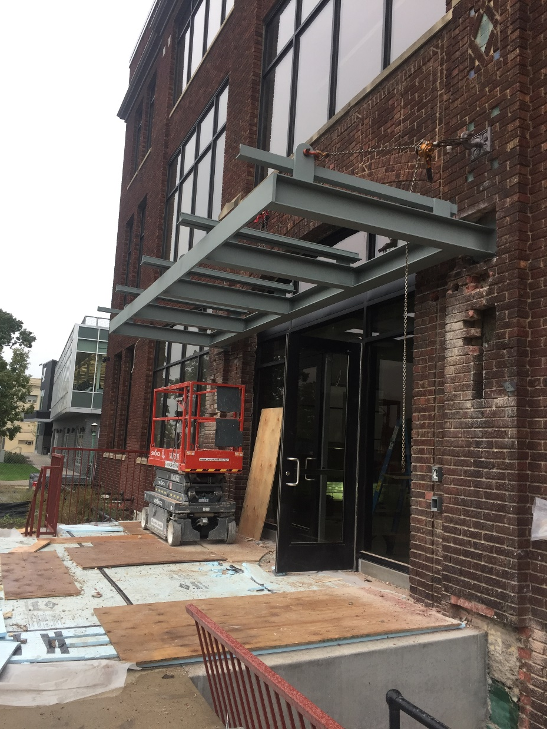

Slide 39
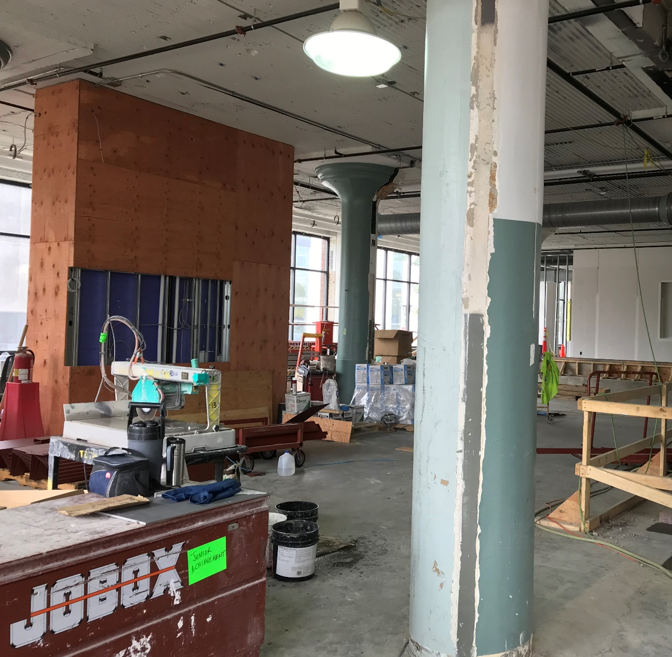
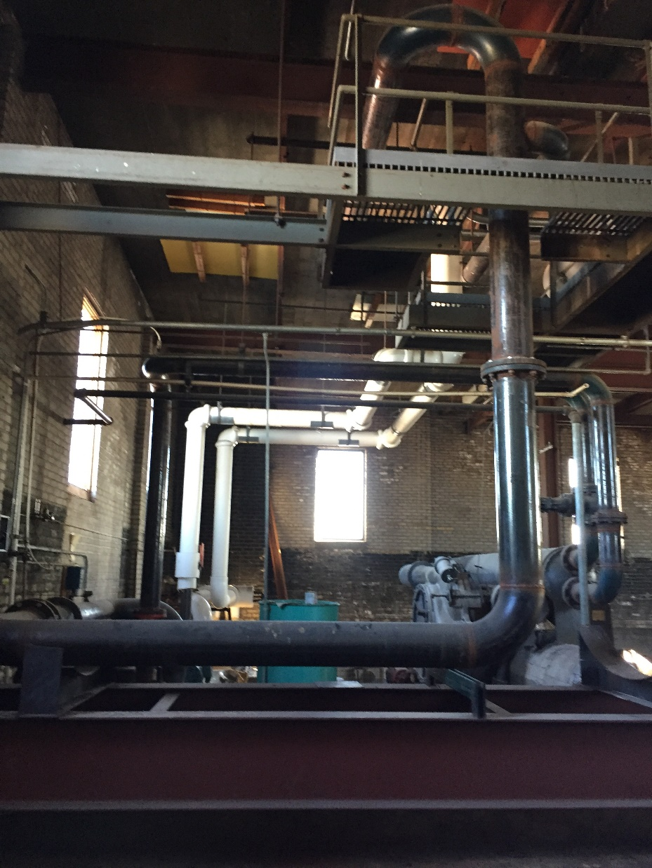

Slide 40
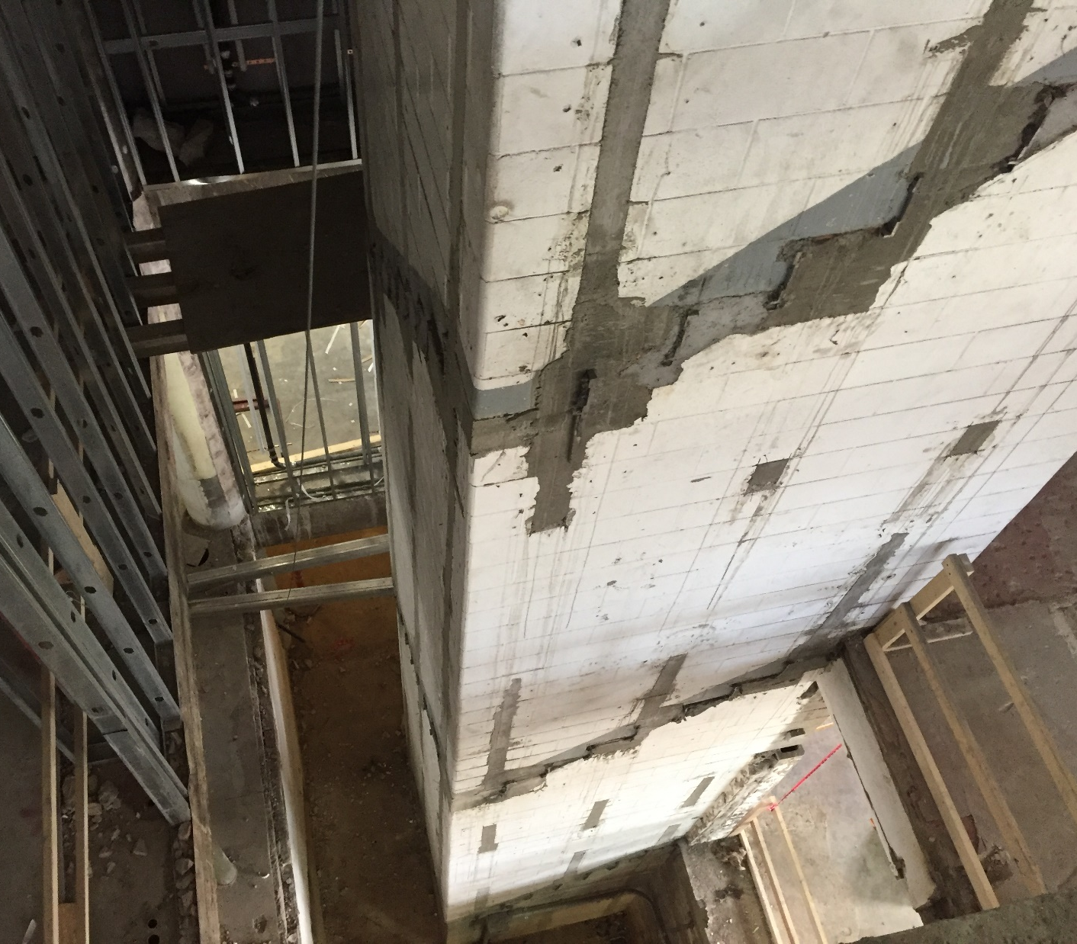
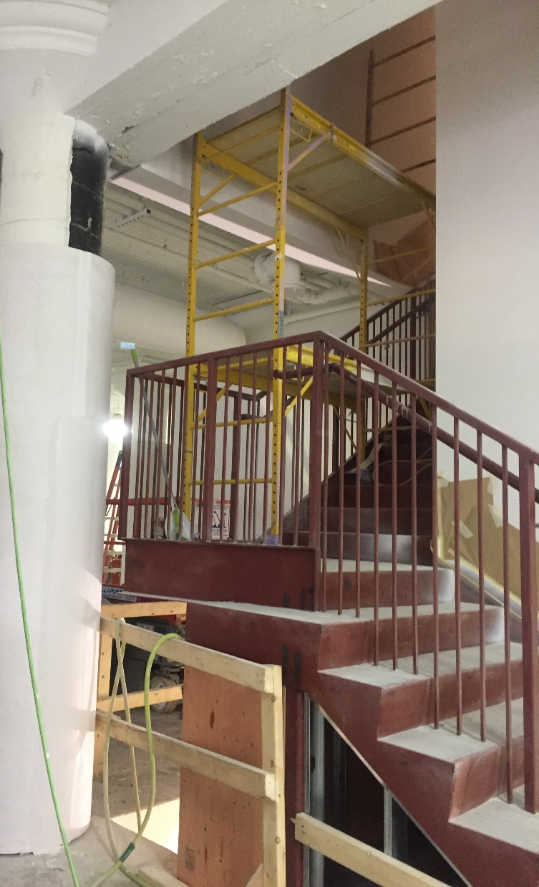

Slide 41
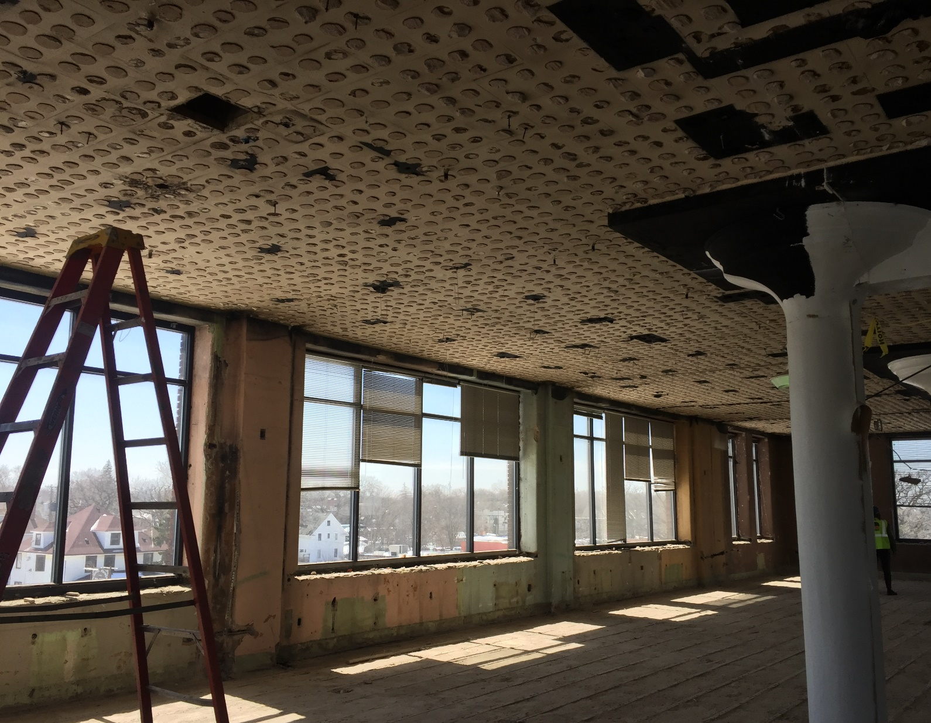


Slide 42


Slide 43


Slide 44


Slide 45



Slide 46



Slide 47


Slide 48



Slide 49


Slide 50
Owner Education
Landing on a site, then a design
Budget driven design when non-profit
Going design build
Decisions, decisions, decisions!
Non-profit specific processes
Notes:
Editable content behind jpgs.

Slide 51
JAUM’s Green Story
Traditional LEED path vs.
Non-traditional LEED path - post construction
High focus on student education
Partners in the community
Notes:
Editable content behind jpgs.

Slide 52
LEED O+M (Operations and Maintenance) Certification
Innovation credits for education
Solar harvesting – panels on roof
with True North and Xcel Energy lease back program
New, more energy efficient
mechanical systems
High efficiency windows replaced on a portion of the building
No VOC interior finishes
Vacancy sensor lighting
Local building products and labor
(Measurement will begin after
1 year of operating)
Notes:
Editable content behind jpgs.

Slide 53
Just the First Chapter
Learning from the building
Once in a lifetime project
Facility manager change end of 2018
  New FM is Fixed Assets MN
Notes:
Editable content behind jpgs.

Slide 54
Thank you.
Jennifer Buck
AIA, LEED AP BD+C
Senior Associate
Jennifer.Buck@rsparch.com
Notes:
Editable content behind jpgs.

